Slide 1
UNIT - IV
Error Detection
and
Correction

Slide 2

Note
Data can be corrupted
during transmission.
Some applications require that
errors be detected and corrected.

Slide 3
INTRODUCTION
Let us discuss some issues related, directly or indirectly, to error detection and correction.
Types of Errors
Redundancy
Detection Versus Correction
Forward Error Correction Versus Retransmission
Coding
Modular Arithmetic

Slide 4
Types of Errors: whenever bits flow from one point to another, they are subject to unpredictable changes because of interference. This interference can change the shape of the signal.
Single-bit Error
Burst Error
In a single-bit error, only 1 bit in the data unit is changed from 1 to 0 or from 0 to 1.

Slide 5

Figure Single-bit error

Slide 6
The burst error means that 2 or more bits in the data unit have changed from 1 to 0 or from 0 to 1.
Note that a burst error does not necessarily mean that the errors occur in consecutive bits.
The length of the burst is measured from the first corrupted bit to the last corrupted bit. Some bits in between may not have been corrupted.

Slide 7

Figure Burst error of length 8

Slide 8
To detect or correct errors, we need to send extra (redundant) bits with data.
These redundant bits are added by the sender and removed by the receiver.
This added redundancy allows the receiver to detect or correct corrupted bits.

Slide 9
Correction of errors is more difficult than the detection. In error correction, we need to know the exact number of bits that are corrupted and their location in the message.
FEC (Forward Error Correction): is the process in which the receiver tries to guess the message by using redundant bits.
Correction by retransmission is a technique in which the receiver detects the occurrence of an error and asks the sender to resend the message.

Slide 10
Redundancy is achieved through various coding schemes. The sender adds redundant bits through a process that creates a relationship between the redundant bits and the actual data bits. The receiver checks the relationship between the two sets of bits to detect or correct the errors.
The ratio of redundant bits to the data bits and the robustness of the process are important factors in any coding scheme.
Figure shows the general idea of coding.

Slide 11

Figure The structure of encoder and decoder

Slide 12

In modular arithmetic, we use only limited number of integers. In modulo-N arithmetic, the upper limit is called a modulus N. We use only the integers in the range 0 to N −1, inclusive. The below shows the Modulo-2 Arithmetic.

Slide 13

BLOCK CODING
In block coding, we divide our message into blocks, each of k bits, called datawords. We add r redundant bits to each block to make the length n = k + r. The resulting n-bit blocks are called codewords.
It is one-to-one process; the same dataword is always encoded as the same codeword. The unused codewords 2^{n} – 2^{k} are called invalid codewords.

Slide 14
Error Detection and Correction
Enough redundancy is to be added to detect/correct an error.
Error correction is much more difficult than error detection.
In error detection, the receiver needs to know only that the received codeword is invalid whereas in error correction the received needs to find/guess the original codeword sent.
The receiver knows an error occurred but does not know which bit(s) is(are) in error.
More redundant bits are needed for error correction than for error detection.

Slide 15
The sender creates codewords out of datawords by using a generator that applies the rules and procedures of encoding.
Each codeword sent to the receiver may change during transmission.
If the received codeword is the same as one of the valid codewords, the word is accepted and the corresponding dataword is extracted for use. If the received codeword is not valid, it is discarded. This idea is the same for error correction also but the checker functions are much more complex.

Slide 16


Figure Process of error detection in block coding
Figure Process of error correction in block coding

Slide 17
Example 1
Let us assume k = 2 and n = 3.
Table 1 shows the list of datawords and codewords.
Assume the sender encodes the dataword 01 as 011 and sends it to the receiver.
Consider the following cases:
The receiver receives 011. It is a valid codeword. The receiver extracts the dataword 01 from it.
2. The codeword is corrupted during transmission, and 111 is received. This is
not a valid codeword and is discarded.
The codeword is corrupted during transmission, and 000 is received. This is a valid codeword. The receiver incorrectly extracts the dataword 00. Two corrupted bits have made the error undetectable.

Slide 18

Table 1 A code for error detection (Example)

Slide 19
Note
An error-detecting code can detect
only the types of errors for which it is designed; other types of errors may remain undetected.

Slide 20
Example2
Let us add more redundant bits to Example 1 to see if the receiver can correct an error without knowing what was actually sent. We add 3 redundant bits to the 2-bit dataword to make 5-bit codewords. Table 2 shows the datawords and codewords. Assume the dataword is 01. The sender creates the codeword 01011. The codeword is corrupted during transmission, and 01001 is received. First, the receiver finds that the received codeword is not in the table. This means an error has occurred. The receiver, assuming that there is only 1 bit corrupted, uses the following strategy to guess the correct dataword.

Slide 21

Table 2 A code for error correction (Example 1)

Slide 22
Example 2 (continued)
1. Comparing the received codeword with the first codeword in the table (01001 versus 00000), the receiver decides that the first codeword is not the one that was sent because there are two different bits.
2. By the same reasoning, the original codeword cannot be the third or fourth one in the table.
3. The original codeword must be the second one in the table because this is the only one that differs from the received codeword by 1 bit. The receiver replaces 01001 with 01011 and consults the table to find the dataword 01.

Slide 23
One of the central concepts in coding for error control is the idea of the Hamming distance.
The Hamming distance between two words is the number of differences between corresponding bits.

Slide 24

Example 3
Let us find the Hamming distance between two pairs of words.
1. The Hamming distance d(000, 011) is 2 because
2. The Hamming distance d(10101, 11110) is 3 because

Slide 25
The measurement, minimum Hamming distance (d_{min}) is used for designing a code.
The minimum Hamming distance is the smallest Hamming distance between all possible pairs in a set of words.
To guarantee the detection of up to s errors in all cases, the minimum Hamming distance in a block code must be d_{min} = s + 1.
To guarantee correction of up to t errors in all cases, the minimum Hamming distance in a block code must be d_{min} = 2t + 1.

Slide 26
Example 4
Find the minimum Hamming distance of the coding scheme in Table 10.1.
Solution
We first find all Hamming distances.
The d_{min} in this case is 2.
This code guarantees detection of only a single error.

Slide 27
Example 5
Find the minimum Hamming distance of the coding scheme in Table 10.2.
Solution
We first find all the Hamming distances.
The d_{min} in this case is 3.
This code can detect up to two errors.

Slide 28
Example 6
A code scheme has a Hamming distance d_{min} = 4. What is the error detection and correction capability of this scheme?
Solution
guarantees the detection of up to three errors
(s = 3), but it can correct up to one error.
Error correction codes need to have an odd
minimum distance (3, 5, 7, . . . ).

Slide 29
10-3 LINEAR BLOCK CODES
Almost all block codes used today belong to a subset called linear block codes.
A linear block code is a code in which the exclusive OR (modulo-2 addition) of any two valid codewords creates another valid codeword.
The d_{min} for a linear block code is the number of 1s in the nonzero valid codeword with the smallest number of 1s.

Slide 30
Some Linear Block Codes
A simple parity-check code is a single-bit error-detecting code in which
n = k + 1 with d_{min} = 2. The extra bit, called the parity bit, is selected to make the total number of 1s in the codeword either even or odd.
In the table 3, even parity is followed.
r₀ = a₃ + a₂ + a₁ + a₀ (modulo-2)
s₀ = b₃ + b₂ + b₁ + b₀ + q₀ (modulo-2)

Slide 31
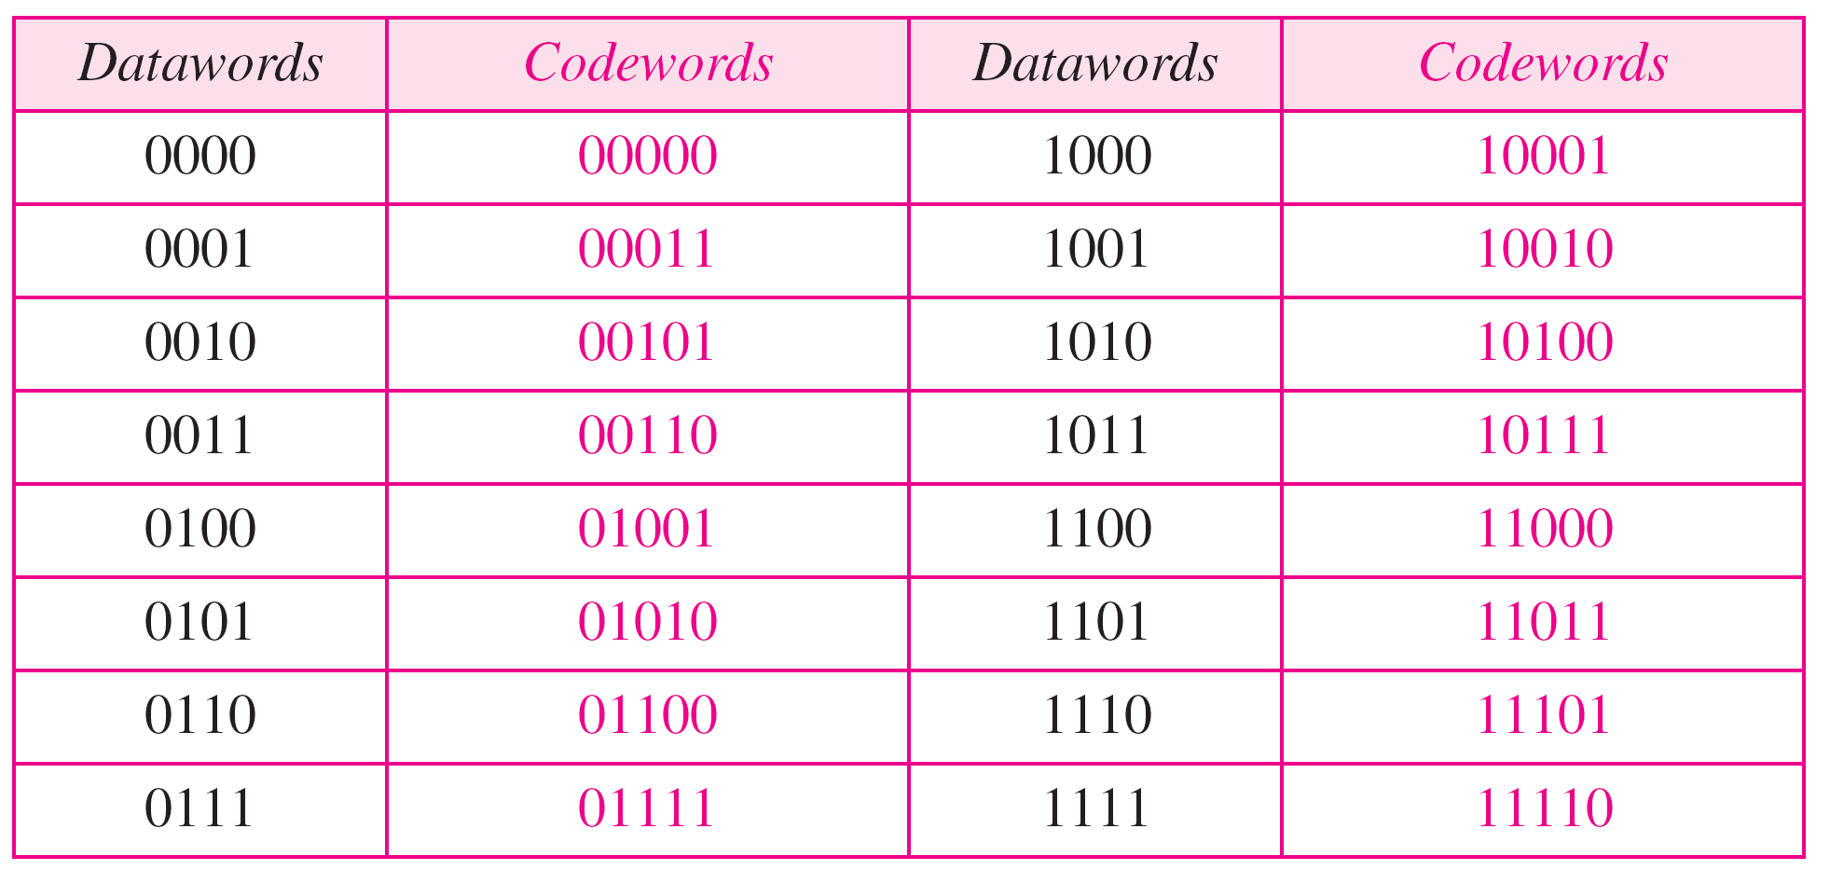
Table 3 Simple parity-check code C(5, 4)

Slide 32

Figure Encoder and decoder for simple parity-check code

Slide 33
Example 7
Assume the sender sends the dataword 1011. The codeword created from this dataword is 10111, which is sent to the receiver.
No error occurs; the received codeword is 10111. The syndrome is 0. The dataword 1011 is created.
One single-bit error changes a₁ . The received codeword is 10011.
The syndrome is 1. No dataword is created.
One single-bit error changes r₀ . The received codeword is 10110. The syndrome is 1. No dataword is created.
An error changes r₀ and a second error changes a₃. The received
codeword is 00110. The syndrome is 0. The dataword 0011 is created at the receiver. Note that here the dataword is wrongly created due to the syndrome value.
Three bits—a₃, a₂, and a₁—are changed by errors. The received
codeword is 01011. The syndrome is 1. The dataword is not created. This shows that the simple parity check, guaranteed to detect one single error, can also find any odd number of errors.

Slide 34
A simple parity-check code can detect an odd number of errors.
A better approach is the two-dimensional parity check.
In this method, the dataword is organized in a table (rows and coloumns). For each row and each coloumn, 1 parity-check bit is calculated. The whole table is then sent to the receiver, which finds the syndrome for each row and each coloumn.
It can detect upto 3 errors that occur anywhere in the table.

Slide 35

Figure Two-dimensional parity-check code

Slide 36



Slide 37
Hamming codes were originally designed with d_{min} = 3 (2 bit error detection or single bit error correction).
A codeword consists of n bits of which k are data bits. We need to choose an integer m>=3. The values of n and k are then: n = 2^{m}-1 and k = n-m.
The number of check bits r = m.

Slide 38
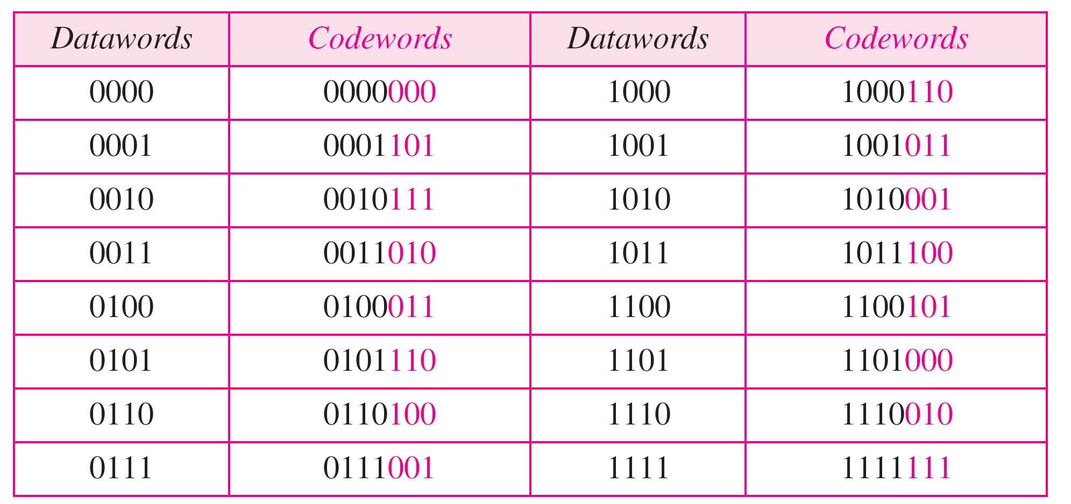
Table Hamming code C(7, 4); n=7, k = 4

Slide 39
Calculating the parity bits at the transmitter:
Modulo 2 arithmetic
r₀ = a₂ + a₁ + a₀ modulo-2
r₁ = a₃ + a₂ + a₁ modulo-2
r₂ = a₁ + a₀ + a₃ modulo-2
Calculating the syndrome at the receiver:
Modulo 2 arithmetic
s₀ = b₂ + b₁ + b₀ + q₀ modulo-2
s₁ = b₃ + b₂ + b₁ + q₁ modulo-2
s₂ = b₁ + b₀ + b₃ + q₂ modulo-2

Slide 40

Figure The structure of the encoder and decoder for the given example

Slide 41

Table Logical decision made by the correction logic analyzer of the
decoder
Note that the generator is not concerned with the four cases shaded in the table because there is either no error or an error in the parity bit. In the other four cases, 1 of the bits must be flipped to find the correct dataword.

Slide 42
Example 8
Let us trace the path of three datawords from the sender to the destination:
The dataword 0100 becomes the codeword 0100011.
The codeword 0100011 is received. The syndrome is 000, the final dataword is 0100.
2. The dataword 0111 becomes the codeword 0111001.
The received codeword is: 0011001. The syndrome is
011. After flipping b₂ (changing the 1 to 0), the final
dataword is 0111.
3. The dataword 1101 becomes the codeword 1101000. The
codeword 0001000 is received. The syndrome is 101.
After flipping b₀, we get 0000, the wrong dataword. This
shows that our code cannot correct two errors.

Slide 43
Example 9
We need a dataword of at least 7 bits. Calculate values of k and n that satisfy this requirement.
Solution
n = 2^{m} − 1, k = n − m
1. If we set m = 3, the result is n = 2³ − 1=7 and k =
7 − 3, or 4, which is < 7.
2. If we set m = 4, then n = 2⁴ − 1 = 15 and k = 15 −
4 = 11, which satisfies the condition k>7. So the
code is
C(15, 11)

Slide 44
Hamming codes to detect Burst Errors
Burst errors are very common, in particular in wireless environments.
A Hamming code can only correct a single error or detect a double error. However, there is a way to make it detect a burst error.
The key is to split a burst error between several codewords, one error for each codeword.
To make the Hamming code respond to a burst error of size N, we need to take N codewords.
Instead of sending one codeword at a time, we arrange the codewords in a table and the bits in the table are sent column by column (from the left). In each column, the bits are sent from the bottom to the top.
Fig. shows that when a burst error of size 4 corrupts the frame, only 1 bit from each codeword is corrupted. The corrupted bit in each codeword can then easily be corrected at the receiver.

Slide 45

Figure Burst error correction using Hamming code

Slide 46
CYCLIC CODES
Cyclic codes are special linear block codes with one extra property. In a cyclic code, if a codeword is cyclically shifted (rotated), the result is another codeword.
Cyclic Redundancy Check
Hardware Implementation
Polynomials
Cyclic Code Analysis
Advantages of Cyclic Codes

Slide 47

Cyclic Redundancy Check (CRC) is a category of cyclic codes used in LANs and WANs.
Table A CRC code with C(7, 4)

Slide 48
In the encoder, the dataword has k bits (4 here); the codeword has n bits (7 here). The size of the dataword is augmented by adding n-k (3 here) 0s to the right-hand side of the word. The n-bit result is fed into the generator. The generator uses a divisor of size n-k+1, predefined and agreed upon. The generator divides the augmented dataword by the divisor (modulo-2 division). The quotient of the division is discarded; the remainder (r₂r₁r₀) is appended to the dataword to create the codeword.
The decoder receives the possibly corrupted codeword. A copy of all n bits is fed to the checker which is a replica of the generator. The remainder produced by the checker is a syndrome of n-k (3 here) bits, which is fed to the decision logic analyzer. If the syndrome bits are all 0s, the 4 leftmost bits of the codeword are accepted as the dataword (interpreted as no error); otherwise the 4 bits are discarded.

Slide 49

Figure CRC encoder and decoder

Slide 50

Figure Division in CRC encoder

Slide 51

Figure Division in the CRC decoder for two cases

Slide 52
Hardware Implementation
One of the advantages of a cyclic code is that the encoder and decoder can easily and cheaply be implemented in hardware by using electronic devices.
Figure The CRC encoder design using shift registers

Slide 53

Figure General design of encoder and decoder of a CRC code

Slide 54

Using polynomials
We can use a polynomial to represent a binary word.
Each bit from right to left is mapped onto a power term.
The rightmost bit represents the “0” power term. The bit next to it the “1” power term, etc.
If the bit is of value zero, the power term is deleted from the expression.

Slide 55
The degree of a polynomial is the highest power in the polynomial.
In a polynomial representation, the divisor is normally called the generator polynomial g(x) or simply the generator.
To find the augmented dataword, we have left-shifted the dataword 3 bits (multiplying by x³).
Division is straightforward; we continue to divided until the degree of the remainder is less than the degree of the divisor.

Slide 56

Figure CRC division using polynomials

Slide 57
In a cyclic code, (syndrome = s(x))
If s(x) ≠ 0, one or more bits is corrupted.
If s(x) = 0, either
a. No bit is corrupted. or
b. Some bits are corrupted, but the
decoder failed to detect them.

Slide 58
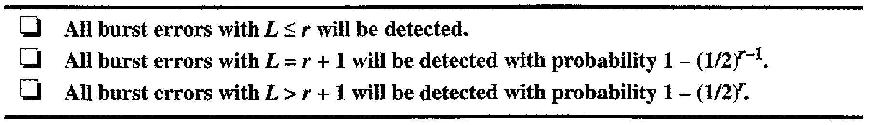
In a cyclic code, those errors that are divisible by g(x) are not caught.
If the generator has more than one term and the coefficient of x⁰ is 1, all single errors can be caught.
If a generator cannot divide x^{t} + 1 (t between 0 and n − 1), then all isolated double errors can be detected.
A generator that contains a factor of x + 1 can detect all odd-numbered errors.

Slide 59
A good polynomial generator needs to have the following characteristics:
1. It should have at least two terms.
2. The coefficient of the term x⁰ should
be 1.
3. It should not divide x^{t} + 1, for t
between 2 and n − 1.
4. It should have the factor x + 1.

Slide 60
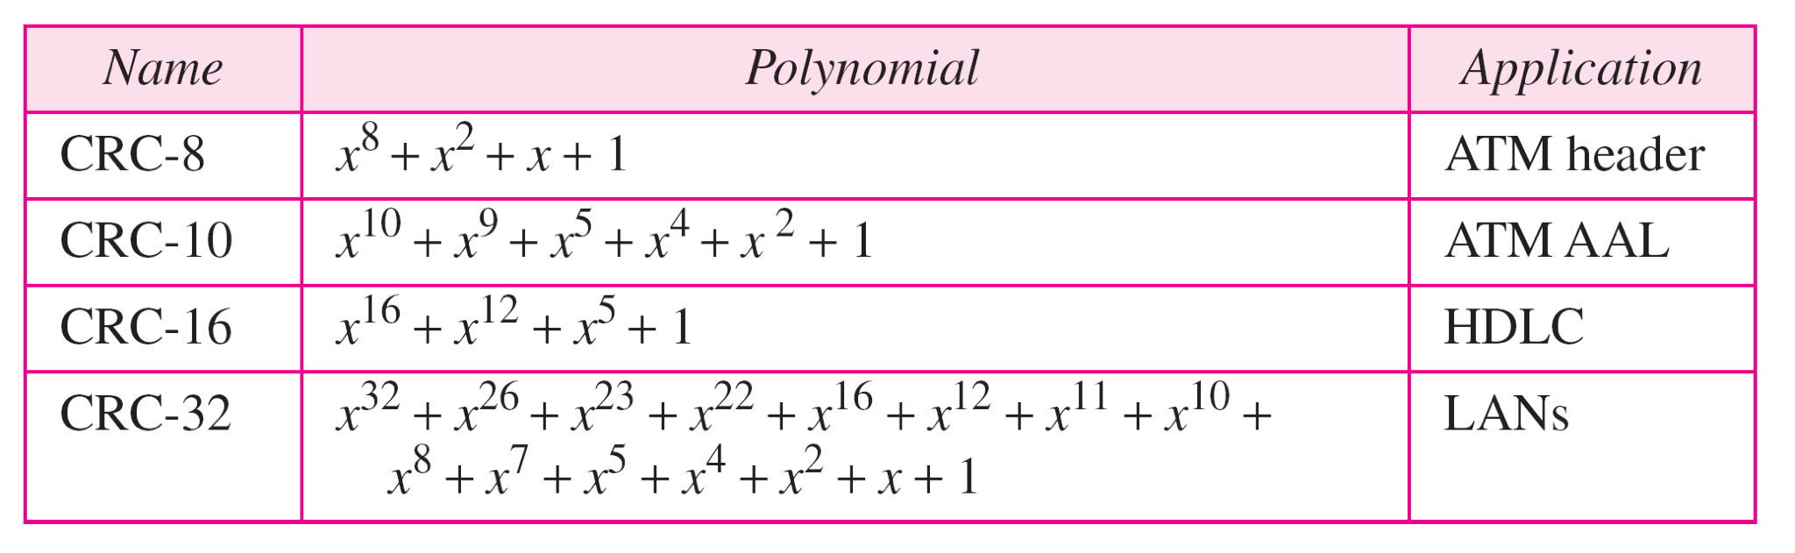
Table Standard polynomials

Slide 61
Advantages of Cyclic Codes
Cyclic codes have a very good performance in detecting single-bit errors, double errors, an odd number of errors, and burst errors.
They can easily be implemented in hardware and software.
They are especially fast when implemented in hardware.

Slide 62
CHECKSUM
The checksum is used in the Internet by several protocols, not at the data link layer.
It is an error detection technique.
One’s Complement
Internet Checksum

Slide 63
Example
Suppose our data is a list of five 4-bit numbers that we want to send to a destination. In addition to sending these numbers, we send the sum of the numbers. For example, if the set of numbers is (7, 11, 12, 0, 6), we send (7, 11, 12, 0, 6, 36), where 36 is the sum of the original numbers. The receiver adds the five numbers and compares the result with the sum. If the two are the same, the receiver assumes no error, accepts the five numbers, and discards the sum. Otherwise, there is an error somewhere and the data are not accepted.

Slide 64
Example
We can make the job of the receiver easier if we send the negative (complement) of the sum, called the checksum. In this case, we send (7, 11, 12, 0, 6, −36). The receiver can add all the numbers received (including the checksum). If the result is 0, it assumes no error; otherwise, there is an error.

Slide 65
One’s complement
If the sum has more than n bits, the extra leftmost bits need to be added to the n rightmost bits (wrapping). The one’s complement of the wrapped sum called checksum will be transmitted together with the datawords.
Two’s complement
If the sum has more than n bits, the extra leftmost bits are discarded and the two’s complement of the result called checksum will be transmitted together with the datawords.

Slide 66
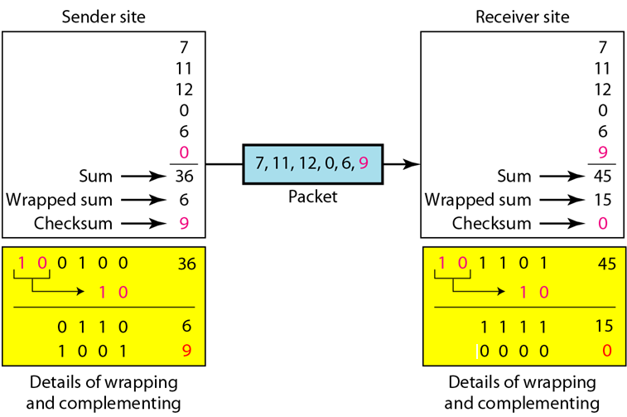
Figure

Slide 67
Internet Checksum
Traditionally, the Internet has been using a
16-bit checksum.
Sender site:
1. The message is divided into 16-bit words.
2. The value of the checksum word is set to 0.
3. All words including the checksum are
added using one’s complement addition.
4. The sum is complemented and becomes the
checksum.
5. The checksum is sent with the data.

Slide 68
Receiver site:
1. The message (including checksum) is
divided into 16-bit words.
2. All words are added using one’s
complement addition.
3. The sum is complemented and becomes the
new checksum.
4. If the value of checksum is 0, the message
is accepted; otherwise, it is rejected.

